Slide 1
Module 3
Innovation - Documentation

Slide 2
The term "Innovation"

Slide 3
The term "innovation" comes from the Latin "novatio", which means "update", and the prefix "in", which is translated from Latin as "in the direction", if you translate verbatim "Innovatio" - "in the direction of change."
A new or significantly improved product (product, service) is introduced, or a process, a new sales method or a new organizational method in business practice, the organization of jobs or in external relations.
Standard STO Railways 08.007-2011 "Innovative activities in JSC" Russian Railways ". Management of the implementation of scientific and technical work"

Slide 4
1. Innovation, which significantly increases the efficiency of the current system.
2. Innovation is traditionally associated with technology; products; organizational forms of existence of the society, such as education, management, labor organization, service, science, informatization.
3. It is aimed at increasing the economy, efficiency, economy, quality of life, etc.
4. Traditionally protected as an intellectual Property (IP).

Slide 5
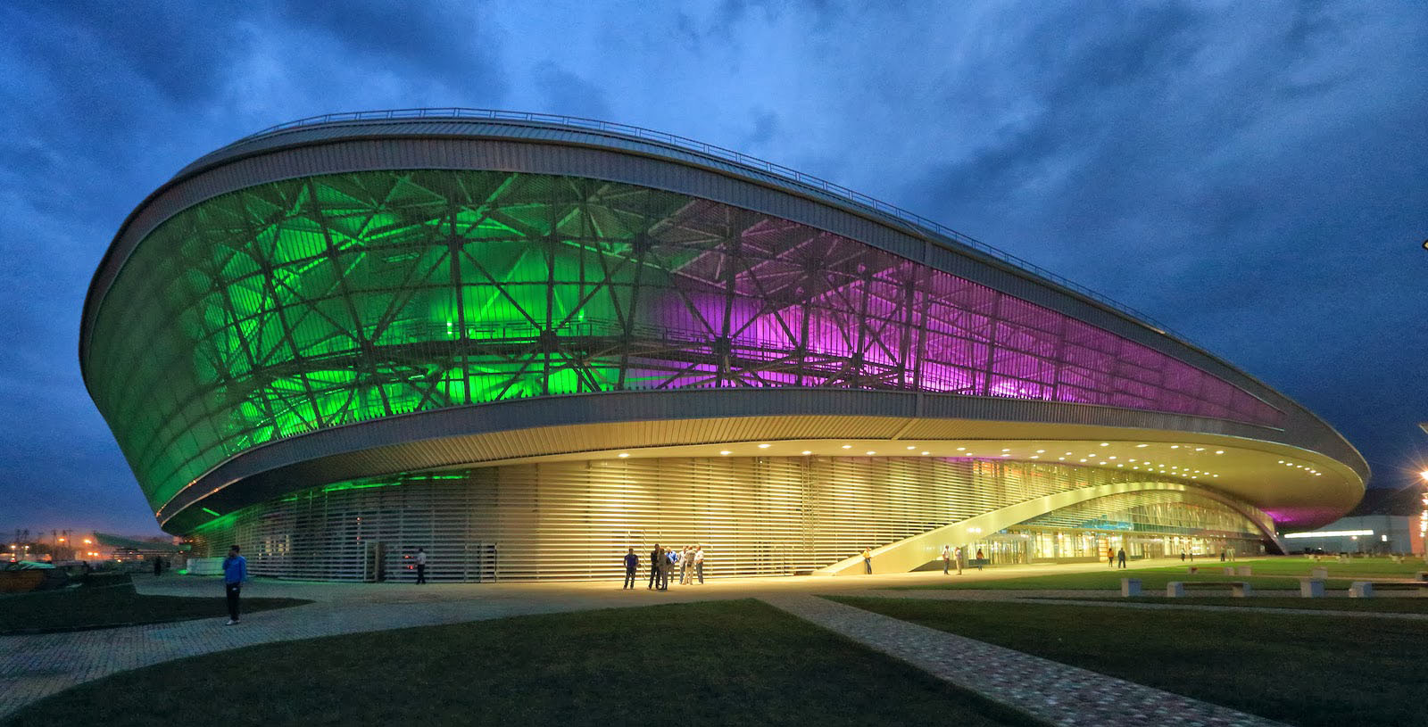
Innovations on the example of objects of the Olympiad in Sochi
INDOOR COVERED PALACE
INDOOR COVERED PALACE

Slide 6
The possibility of flexible regulation of temperature conditions in different zones of the skating oval.
The ice mass is formed by patented technologies, taking into account the specifics of the passage by athletes of straight sections of distance and bends.
Energy-saving glasses cover part of the dome-ellipsoid. Glazing is performed from two opposite sides of the arena.
With the onset of twilight the roof turns into a screen capable of broadcasting different images. For this purpose, 38 thousand energy-efficient LEDs are installed in the roof surface.
Etc.

Slide 7
Innovation and management of intangible assets

Slide 8

TUI AG
Transnational Corporation, since 1973, has been acting as a tourist operator.
Also, the group owns a number of airlines, manages hotel brands, cruise lines, online services.
The company operates in Europe, Africa and other countries.

Slide 9
HOTEL BRANDS
Atlantica Hotels
Dorfhotel
Gran Resort Hotels
Grecotel
Grupotel
Iberotel
MAGIC LIFE
RIU Hotels (50%)
ROBINSON Club
Jaz Hotels
Sol and Mar etc
AIRLINES
Germany - TUIfly
Austria - TUIfly
United Kingdom - Thomson Airways
Sweden - TUIfly Nordic
France - Corsairfly
Belgium - Jetairfly
Netherlands - Arkefly
Morocco - Jet4You et

Slide 10
INNOVATIVE DIRECTIONS
Several hotels have developed technologies to protect the climate (minimizing carbon dioxide emissions); opportunities to use alternative energy sources.
An innovative concept of organization of successful sea cruises (it is a complex family holiday resort on several ships), including the luxury segment.
The use of biofuels in aviation (technology questions).
Entering new markets of Russia and China (through the organization of a network of franchises).

Slide 11
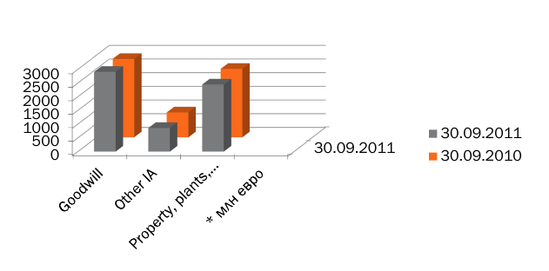
Goodwill – reputaions of action
Goodwill is an economic term used in accounting, trading transactions to reflect the market value of a company after deducting the book value of assets and liabilities.

Slide 12
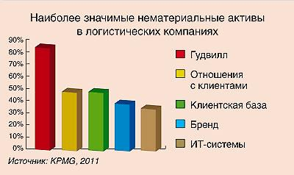

Slide 13

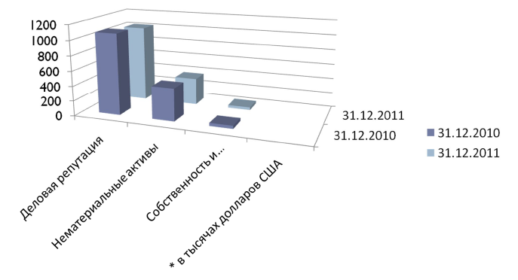

Slide 14

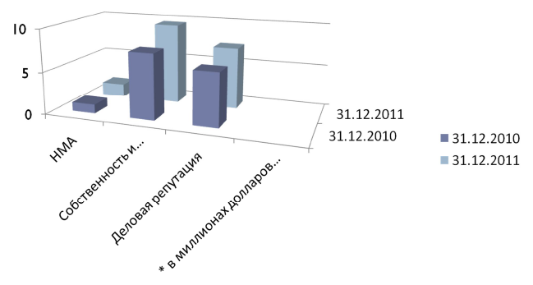

Slide 15

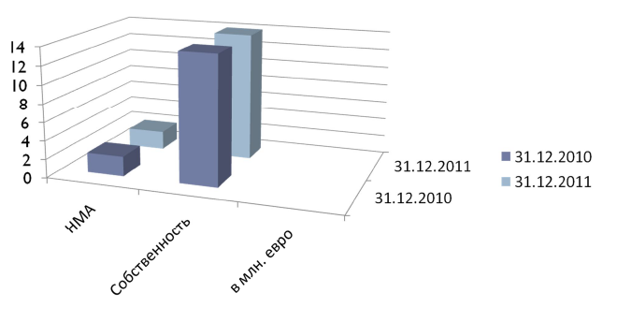
The German energy concern, one of the largest electricity producers and owners of the country's electric grids.

Slide 16

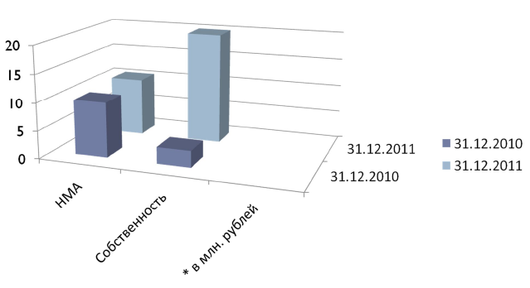
Machine building division of the State Corporation "Rosatom". It unites more than 50 Russian and foreign companies, including manufacturing enterprises, engineering centers and research organizations.

Slide 17

United engineering inductry (Uralmash-Izhora Group) are a company of Russia.
It specializes in engineering, production, sales and service of equipment and machines for nuclear, oil and gas, mining, and the production of metallurgical blanks from special steel grades.
Key business lines of OMZ:
Equipment for nuclear power engineering
Engineering and equipment for the petrochemical complex
Special steel products
Mining equipment
General mechanical engineering

Slide 18
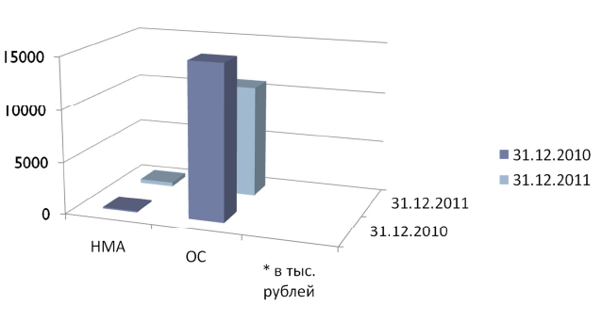

Slide 19
Innovations in project documentation

Slide 20
1
2
Creation of special innovative documentation
3
Interconnection of innovative documentation with issues of protection of intellectual property and intangible assets
Fixing in the project documentation (business plans) information about the features of innovation activity

Slide 21
INNOVATIVE DOCUMENTATION ON THE EXAMPLE OF JSC “Russian Railways”
1. Standards of organization
1.1. Railways 1.08.007-2009 "Innovative activity. Management of the implementation of scientific and technical work";
1.2.Railways 1.08.005-2008 "Innovative activities. The procedure for evaluating the effectiveness of
1.3. Railways 1.08.003-2008 "Innovation. Stages of the life cycle and certification of an innovative project";
1.4. Railways 1.08.004-2008 "Innovative activity. Procedure for recording results";
1.5. Railways 1.08.006-2009 "Innovative activities. Organization of technical audit of R & D results";
1.6. Railways 1.08.008-2009 "Innovative activity. Evaluation of the effectiveness of subsidiaries and affiliates of the scientific and technical complex".

Slide 22
2. Basic documents
2.1.Strategy for the development of railway transport in the Russian Federation until 2030
2.2. Strategic directions of scientific and technological development of Russian Railways for the period till 2015
2.3. The concept of a single technical policy of the Russian Railways holding
2.4. The energy strategy of JSC "Russian Railways" for the period until 2010 and for the future until 2030
2.5. The environmental strategy of Russian Railways for the period until 2015 and for the future until 2030.
3. Additionally
3.1. Approved requirements for innovative projects in the field of railway transport (order of JSC "Russian Railways" of 12/30/2009 No. 2752r).
3.2. A set of requirements for a corporate integrated quality management system of JSC Russian Railways (order of JSC Russian Railways No. 1412p dated June 30, 2010) was approved.

Slide 23
INNOVATIVE DOCUMENTATION ON THE EXAMPLE OF JSC “Russian Railways”
4. Brief results:
4.1. The number of patents for created development has tripled in 2009 (2008 - 134 pcs., 2009 - 400 pcs.).
4.2. The result of working with objects of intellectual property in JSC "Russian Railways" was the increase in intangible assets in 2009 more than tripled. Put on the balance of the results of completed R & D in the amount of more than 1.8 milliard rubles.

Slide 24
STANDARD STO RZD 08.007-2011 "INNOVATIVE ACTIVITY IN OAO RZD. MANAGEMENT OF REALIZATION OF SCIENTIFIC AND TECHNICAL WORKS"
THE MANAGEMENT OF THE IMPLEMENTATION OF SCIENTIFIC AND TECHNICAL WORKS IS PRODUCED AT ALL STAGES OF THEIR LIFE CYCLE
at the stage of preparation of proposals on the need to perform R & D
at the stage of research, development and technological works
at the stage of drawing up an application for the inclusion of work in the NTR plan of JSC “Russian Railways”
at the stage of implementation and use of work results

Slide 25
Railways 1.08.003-2008. INNOVATIVE ACTIVITY. STAGES OF THE LIFE CYCLE AND PASSPORTIZATION OF THE INNOVATION PROJECT
PASSPORT OF THE INNOVATIVE OBJECT

Slide 26
SECTION 1. INFORMATION ABOUT THE INITIATION OF INCLUSION IN THE WORK PLAN OF THE NTR
date of the application;
the intended performer;
requested funding amount (project price);
deadlines for the work (start, end);
name of the work;
aim of the work;
a summary of the substance of the proposal;
list of expected results;
proposals for the proposed implementation;
a list of all potentially protectable results (IP objects);
declared indicators of technical and economic efficiency;
information on the results of consideration of the application;
information about the inclusion of the project in the plan NTR of JSC “Russian Railways”.

Slide 27
SECTION 2. INFORMATION ABOUT THE IMPLEMENTATION OF RESEARCH, EXPERIMENTAL AND DESIGN AND TECHNOLOGICAL WORKS
date and number of the contract for the performance of research, developmental or technological work;
price of work without VAT;
dates and numbers of additional agreements, if any;
deadlines for the work in accordance with the work plan;
name and code of work;
name of the performer and co-performers;
information about the results obtained;
information about the documents on the acceptance of work;
information on reporting documents transferred to the functional customer by the contractor in accordance with the contract;
information about the termination of the contract initiated by JSC Russian Railways or the contractor.

Slide 28
SECTION 3. INFORMATION ABOUT THE USE OF RESULTS OF SCIENTIFIC AND TECHNICAL WORKS, PERFORMED IN ACCORDANCE WITH THE PLAN OF SCIENTIFIC AND TECHNICAL DEVELOPMENT OF JSC “RZD”
list of created scientific and technical results;
the created technical and economic effect calculated on the date of certification;
information about the fact and the volume of implementation of the results of work;
the actual payback period;
reasons for completing the use of work results;
information about the security documents on intellectual property obtained in the performance of work.

Slide 29
THANK YOU FOR WATCHING!!!

